Slide 1
Exploring Animation and OpenGL
In Android
Satya Komatineni
Active Intellect, Inc.
(http://www.satyakomatineni.com)
In Pursuit of Education and Entertainment on hand held computers

Slide 2
About me
Aspire Web - A little known Java/Web fluent platform (my toil)
KnowledgeFolders - Research, Documentation, Productivity, Education, My Public Presence, Book Writing
Pro Android – A Mobile book that I have co-authored with Sayed Hashimi for Apress.

Slide 3
Why this session?
Marketing
How does it work?
(Essentials)
Advanced
Tell me how it works (Animation and OpenGL)
Let me get a sense of how easy or difficult is this to do
What is my learning curve?
How can you help me to get up to speed?
Does this give me a lay of the land?
Do I have a reason to get excited about it?

Slide 4
My High Level Plan
Say a little bit about Android (really little)
Talk about Animation
Talk about OpenGL
Resources

Slide 5
In Animation
Frame Animation
List Animation
View Animation

Slide 6
In OpenGL…
Android OpenGL architecture
Drawing Primitives
Setting the Camera and Understanding Coordinates
Draw a Triangle and Play with Camera
Draw any Polygon
Apply Textures
Draw Multiple times
What helped me!

Slide 7
Intro To Android

Slide 8
What is Android SDK?
Linux based OS under the hood
Java based Custom Virtual Machine called Dalvik
At release level 1.5 and aiming for 2.0 in December
Supports a device emulator well integrated into Eclipse
Integrated browser similar to Chrome (Webkit)
2D and 3D (through OpenGL ES 1.0)
Full media support including recording (audio and video)
GSM Telephony
Bluetooth, EDGE, 3G, and WiFi
Camera, GPS, compass, and accelerometer
Animation based on frames and also tweening

Slide 9
Notable Pieces of Android
A Modern Declarative UI (through XML and Java)
REST/Content Providers and SQLite
Well integrated, simple Eclipse based IDE
Lot of built-in support for Animation and OpenGL ES
A comprehensive “ONE” package to deal with (Very programmer friendly)
Very highly multi-threaded

Slide 10
Hello World
public class HelloAndroid extends Activity
{
public void onCreate(Bundle savedInstanceState)
{
super.onCreate(savedInstanceState);
setContentView(R.layout.main);
}
}
<?xml version="1.0" encoding="utf-8"?>
<TextView xmlns:android="http://schemas.android.com/apk/res/android"
android:layout_width="fill_parent"
android:layout_height="fill_parent"
android:text="Hello, Android"/>
public final class R {
public static final class attr {
};
public static final class drawable {
public static final int icon=0x7f020000;
};
public static final class layout {
public static final int main=0x7f030000;
};
public static final class string {
public static final int app_name=0x7f040000;
};
};

Slide 11
Layout XML
<LinearLayout xmlns:android="http://schemas.android.com/apk/res/android"
android:layout_width="wrap_content"
android:layout_height="wrap_content"
android:orientation="vertical"
android:paddingLeft="6dip"
android:paddingRight="6dip"
android:paddingBottom="3dip">
<EditText android:id="@+id/title"
android:maxLines="1"
android:layout_marginTop="2dip"
android:layout_width="wrap_content"
android:ems="25"
android:layout_height="wrap_content"
android:autoText="true"
android:capitalize="sentences"
android:scrollHorizontally="true" />
<Button android:id="@+id/ok"
android:layout_width="wrap_content"
android:layout_height="wrap_content"
android:layout_gravity="right"
android:text="@string/button_ok" />
</LinearLayout>

Slide 12
Manifest.xml
<manifest xmlns:android="http://schemas.android.com/apk/res/android"
package="com.example.android.notepad"
>
<application android:icon="@drawable/app_notes"
android:label="@string/app_name"
>
<provider android:name="NotePadProvider"
android:authorities="com.google.provider.NotePad"
/>
<activity android:name="NotesList" android:label="@string/title_notes_list">
<intent-filter>
<action android:name="android.intent.action.MAIN" />
<category android:name="android.intent.category.LAUNCHER" />
</intent-filter>
<intent-filter>
<action android:name="android.intent.action.VIEW" />
<action android:name="android.intent.action.EDIT" />
<action android:name="android.intent.action.PICK" />
<category android:name="android.intent.category.DEFAULT" />
<data android:mimeType="vnd.android.cursor.dir/vnd.google.note" />
</intent-filter>
<intent-filter>
<action android:name="android.intent.action.GET_CONTENT" />
<category android:name="android.intent.category.DEFAULT" />
<data android:mimeType="vnd.android.cursor.item/vnd.google.note" />
</intent-filter>
</activity>
<activity android:name="NoteEditor"
android:theme="@android:style/Theme.Light"
android:label="@string/title_note"
>

Slide 13
Packages
Opengl
Os
Preference
Provider
Sax
Telephony
Telephony.gsm
Text
Text.method
Text.style
Text.util
View
View.animation
Webkit
Widget
Com.google.android.maps
Java.*
Javax.*
Junit.*
Org.apache.http.*
Org.json
Org.xml.*
App
Content
Content.pm
Content.res
Database
Database.sqlite
Graphics
Graphics.drawable
Graphics.drawable.shapes
Hardware
Location
Media
Net
Net.http
Net.wifi

Slide 14
Animation

Slide 15
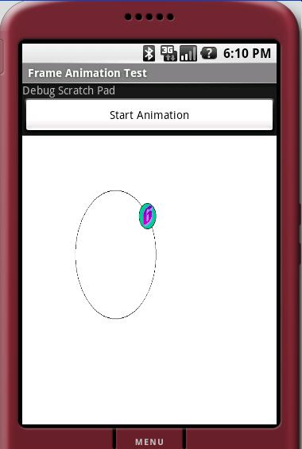
Frame Animation

Slide 16
Frame Animation: XML Definition
<?xml version="1.0" encoding="utf-8"?>
<animation-list xmlns:android="http://schemas.android.com/apk/res/android"
android:oneshot="false">
<item android:drawable="@drawable/numbers11" android:duration="50" />
<item android:drawable="@drawable/numbers12" android:duration="50" />
<item android:drawable="@drawable/numbers13" android:duration="50" />
<item android:drawable="@drawable/numbers14" android:duration="50" />
<item android:drawable="@drawable/numbers15" android:duration="50" />
<item android:drawable="@drawable/numbers16" android:duration="50" />
<item android:drawable="@drawable/numbers17" android:duration="50" />
<item android:drawable="@drawable/numbers18" android:duration="50" />
<item android:drawable="@drawable/numbers19" android:duration="50" />
</animation-list>

Slide 17
Frame Animation: Java code
private void animate() {
ImageView imgView = (ImageView)findViewById(R.id.imageView);
imgView.setVisibility(ImageView.VISIBLE);
imgView.setBackgroundResource(R.drawable.frame_animation);
AnimationDrawable frameAnimation =
(AnimationDrawable) imgView.getBackground();
frameAnimation.running() ?
frameAnimation.stop():
frameAnimation.start();
}

Slide 18
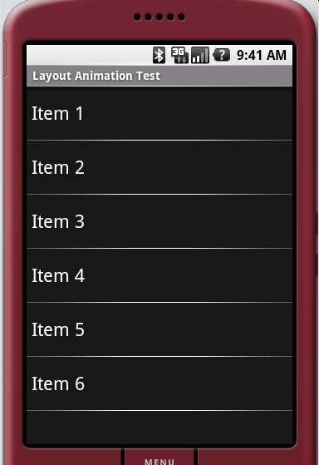
A ViewGroup or List Animation
(Also called Layout Animation)

Slide 19
List Animation: XML Definition
<?xml version="1.0" encoding="utf-8"?>
<LinearLayout xmlns:android=http://schemas.android.com/apk/res/android
……
>
<ListView
android:id="@+id/list_view_id"
android:persistentDrawingCache="animation|scrolling"
android:layout_width="fill_parent"
android:layout_height="fill_parent"
android:layoutAnimation="@anim/list_layout_controller" />
/>
</LinearLayout>

Slide 20
List Animation: adapter
<layoutAnimation xmlns:android="http://schemas.android.com/apk/res/android"
android:delay="30%"
android:animationOrder="reverse"
android:animation="@anim/alpha_translate" />

Slide 21
Alpha and Translate Animation: An Example
<set xmlns:android="http://schemas.android.com/apk/res/android"
android:interpolator="@android:anim/accelerate_interpolator">
<translate android:fromYDelta="-100%"
android:toYDelta="0"
android:duration="500" />
<alpha android:fromAlpha="0.0"
android:toAlpha="1.0"
android:duration="500" />
</set>

Slide 22
Rotate and Scale Animation: An Example
<rotate xmlns:android="http://schemas.android.com/apk/res/android"
android:interpolator="@android:anim/accelerate_interpolator"
android:fromDegrees="0.0"
android:toDegrees="360"
android:pivotX="50%"
android:pivotY="50%"
android:duration="500" />
<set xmlns:android="http://schemas.android.com/apk/res/android"
android:interpolator="@android:anim/accelerate_interpolator">
<scale
android:fromXScale="1” android:toXScale="1"
android:fromYScale="0.1” android:toYScale="1.0"
android:duration="500” android:pivotX="50%"
android:pivotY="50%” android:startOffset="100" />
</set>

Slide 23
Interpolators: Definition and Java code
<accelerateInterpolator
xmlns:android="http://schemas.android.com/apk/res/android"
factor="1" />
public float getInterpolation(float input)
{
if (mFactor == 1.0f) {
return (float)(input * input);
}
else {
return (float)Math.pow(input, 2 * mFactor);
}
}

Slide 24
Available Interpolators
AccelerateDecelerateInterpolator
AccelerateInterpolator
CycleInterpolator
DecelerateInterpolator
LinearInterpolator

Slide 25
View Animation: A different take

Slide 26
Attach Animation to a View
View someView;
someView.startAnimation(new ViewAnimation());

Slide 27
View Animation
public class ViewAnimation extends Animation
{
public void initialize(int width, int height, int parentWidth, int parentHeight) {
super.initialize(width, height, parentWidth, parentHeight);
setDuration(2500);
setFillAfter(true);
setInterpolator(new LinearInterpolator());
}
protected void applyTransformation(float interpolatedTime, Transformation t)
{
final Matrix matrix = t.getMatrix();
matrix.setScale(interpolatedTime, interpolatedTime);
matrix.preTranslate(-centerX, -centerY);
matrix.postTranslate(centerX, centerY); }
}

Slide 28
Applying a 2D Camera
protected void applyTransformation(float interpolatedTime, Transformation t)
{
final Matrix matrix = t.getMatrix();
camera.save();
camera.translate(0.0f, 0.0f, (1300 - 1300.0f * interpolatedTime));
camera.rotateY(360 * interpolatedTime);
camera.getMatrix(matrix);
matrix.preTranslate(-centerX, -centerY);
matrix.postTranslate(centerX, centerY);
camera.restore();
}

Slide 29
OpenGL ES 1.0

Slide 30
How I Justify My Frustration with OpenGL
When the Goal of Each Step is Fun,
the Journey in the End is Profitable.

Slide 31
Key APIs to understand
glVertexPointer
glDrawElements
gluLookAt
glFrustum
glViewPort
glTexturePointer

Slide 32
Key Observations
There is a lot of OpenGL documentation
There is very little GOOD OpenGL documentation
Most books overlook the basic concepts
The flat “c” api makes it very difficult to understand the OpenGL state machine

Slide 33
Beginner Suggestions
Get a good list of resources, including OpenGL books
Understand the OpenGL Camera paradigm really well
You cannot use Java buffers use native “nio” buffers
Nio buffers use a part of the memory that is outside the JVM but they do clean themselves when gc is run
Know that you can call “glDrawElements” multiple times by changing transformation matrices to draw multiple figures
Typically Textures and Surfaces are drawn together so you will have to use item 4

Slide 34
An attempt at a triangle
//Clear the surface of any color
gl.glClear(gl.GL_COLOR_BUFFER_BIT);
//Set the current color
gl.glColor4f(1.0f, 0, 0, 0.5f);
//There are three points (floats) in the specificed buffer pointer
gl.glVertexPointer(3, GL10.GL_FLOAT, 0, mFVertexBuffer);
//Draw them assuming they form triangles
//there are 3 points
gl.glDrawElements(GL10.GL_TRIANGLE_STRIP, 3,
GL10.GL_UNSIGNED_SHORT, mIndexBuffer);

Slide 35
Primitive Shapes
GL_TRIANGLE_STRIP
GL_POINTS
GL_LINE_STRIP
GL_LINES
GL_LINE_LOOP
GL_TRIANGLES
GL_TRIANGLE_FAN

Slide 36
How you use NIO buffers: A vertex Example
java.nio.ByteBuffer vbb = ByteBuffer.allocateDirect(VERTS * 3 * 4);
vbb.order(ByteOrder.nativeOrder());
java.nio.FloatButffer mFVertexBuffer = vbb.asFloatBuffer();
float[] coords = {
-0.5f, -0.5f, 0, // (x1,y1,z1)
0.5f, -0.5f, 0,
0.0f, 0.5f, 0 };
for (int i = 0; i < VERTS; i++) {
for(int j = 0; j < 3; j++) {
mFVertexBuffer.put(coords[i*3+j]);
}}
mFVertexBuffer.position(0);

Slide 37
How you use NIO buffers: An Index Example
java.nio.ByteBuffer ibb = ByteBuffer.allocateDirect(VERTS * 2);
ibb.order(ByteOrder.nativeOrder());
java.nio.ShortBuffer mIndexBuffer = ibb.asShortBuffer();
short[] myIndecesArray = {0,1,2};
for (int i=0;i<3;i++)
{
mIndexBuffer.put(myIndecesArray[i]);
}
mIndexBuffer.position(0);

Slide 38
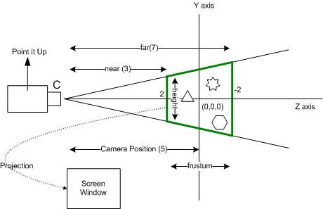
Camera and Coordinates
glFrustum
gluLookAt
glViewPort

Slide 39
How you use NIO buffers: An Index Example
//Look at the screen (origin) from 5 units away from the front of the screen
GLU.gluLookAt(gl, 0,0,5, 0,0,0, 0,1,0);
//Set the height to 2 units and depth to 4 units
gl.glFrustumf(-ratio, ratio, -1, 1, 3, 7);
//normal window stuff
gl.glViewport(0, 0, w, h);

Slide 40
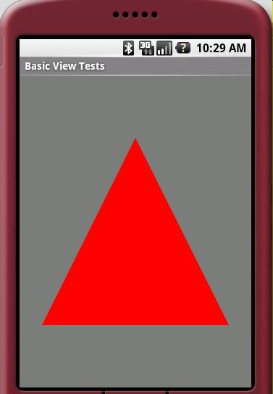
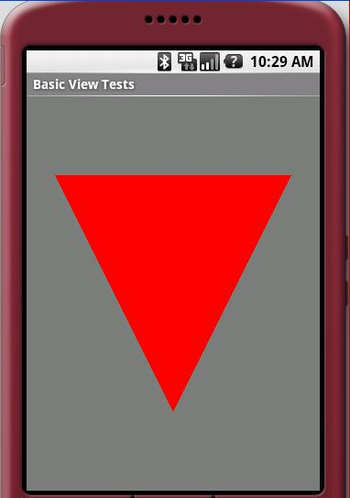
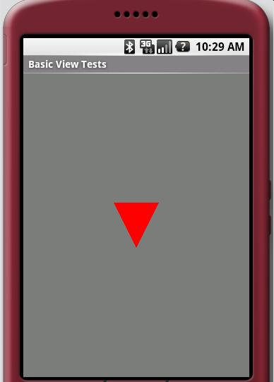
Changing Your Scene Settings
Up right gluLookAt
Look down gluLookAt
4 times frustum

Slide 41
Putting it All Together
public class OpenGL15TestHarnessActivity extends Activity
{
private GLSurfaceView mTestHarness;
@Override
protected void onCreate(Bundle savedInstanceState) {
super.onCreate(savedInstanceState);
mTestHarness = new GLSurfaceView(this);
mTestHarness.setEGLConfigChooser(false);
mTestHarness.setRenderer(new SimpleTriangleRenderer(this));
mTestHarness.setRenderMode(
GLSurfaceView.RENDERMODE_WHEN_DIRTY);
setContentView(mTestHarness);
}

Slide 42
What is a Renderer
public static interface GLSurfaceView.Renderer
{
void onDrawFrame(GL10 gl);
void onSuraceChanged(GL10 gl, int width, int height);
void onSurfaceCreated(GL10 gl, EGLConfig config);
}

Slide 43
What goes into onSurfaceCreated
public abstract class AbstractRenderer
implements GLSurfaceView.Renderer
{
public void onSurfaceCreated(GL10 gl, EGLConfig eglConfig) {
gl.glDisable(GL10.GL_DITHER);
gl.glHint(GL10.GL_PERSPECTIVE_CORRECTION_HINT,
GL10.GL_FASTEST);
gl.glClearColor(.5f, .5f, .5f, 1);
gl.glShadeModel(GL10.GL_SMOOTH);
gl.glEnable(GL10.GL_DEPTH_TEST);
}

Slide 44
What goes into onSurfaceChanged
public void onSurfaceChanged(GL10 gl, int w, int h) {
gl.glViewport(0, 0, w, h);
float ratio = (float) w / h;
gl.glMatrixMode(GL10.GL_PROJECTION);
gl.glLoadIdentity();
gl.glFrustumf(-ratio, ratio, -1, 1, 3, 7);
}

Slide 45
What goes into onDrawFrame
public void onDrawFrame(GL10 gl)
{
gl.glDisable(GL10.GL_DITHER);
gl.glClear(GL10.GL_COLOR_BUFFER_BIT | GL10.GL_DEPTH_BUFFER_BIT);
gl.glMatrixMode(GL10.GL_MODELVIEW);
gl.glLoadIdentity();
GLU.gluLookAt(gl, 0, 0, -5, 0f, 0f, 0f, 0f, 1.0f, 0.0f);
gl.glEnableClientState(GL10.GL_VERTEX_ARRAY);
//Actual drawing can happen in a concrete class
draw(gl);
}

Slide 46
Brief Architecture of GLSurfaceView
Use
GLSurfaceView
Renderer
(Interface)
Specialize
Abstract
Renderer
(Interface)
Specialize
Rectangle
Renderer
General
Polygon
Renderer
Triangle
Renderer

Slide 47
Drawing Any Polygon
RegularPolygon t = new RegularPolygon(0,0,0,1,sides);
this.mFVertexBuffer = t.getVertexBuffer();
this.mIndexBuffer = t.getIndexBuffer();
this.numOfIndecies = t.getNumberOfIndecies();
this.mFVertexBuffer.position(0);
this.mIndexBuffer.position(0);
gl.glColor4f(1.0f, 0, 0, 0.5f);
gl.glVertexPointer(3, GL10.GL_FLOAT, 0, mFVertexBuffer);
gl.glDrawElements(GL10.GL_TRIANGLES, this.numOfIndecies,
GL10.GL_UNSIGNED_SHORT, mIndexBuffer);

Slide 48
I can animate that polygon
long curtime = SystemClock.uptimeMillis();
if ((curtime - prevtime) > 2000) {
prevtime = curtime;
sides += 1;
if (sides > 20) { sides = 3; }
this.prepareBuffers(sides);
}
gl.glColor4f(1.0f, 0, 0, 0.5f);
gl.glVertexPointer(3, GL10.GL_FLOAT, 0, mFVertexBuffer);
gl.glDrawElements(GL10.GL_TRIANGLES, this.numOfIndecies,
GL10.GL_UNSIGNED_SHORT, mIndexBuffer);

Slide 49
Adding Texture
(1,1)
(0,0)
Object
bitmap

Slide 50
Figure out texture coordinates
(1,1)
(0,0)

Slide 51
Abstract Textured Renderer
Specialize
Use
GLSurfaceView
Renderer
(Interface)
Abstract
Renderer
(Interface)
Specialize
Abstract
TextureRenderer
(Interface)
Textured
Polygon
Renderer

Slide 52
Setup Your Texture in OnSurfaceCreated
int[] textures = new int[1]; gl.glGenTextures(1, textures, 0);
mTextureID = textures[0];
gl.glBindTexture(GL10.GL_TEXTURE_2D, mTextureID);
gl.glTexParameterf(GL10.GL_TEXTURE_2D, GL10.GL_TEXTURE_MIN_FILTER,
GL10.GL_NEAREST);
gl.glTexParameterf(GL10.GL_TEXTURE_2D,
GL10.GL_TEXTURE_MAG_FILTER,
GL10.GL_LINEAR);
gl.glTexParameterf(GL10.GL_TEXTURE_2D, GL10.GL_TEXTURE_WRAP_S,
GL10.GL_CLAMP_TO_EDGE);
gl.glTexParameterf(GL10.GL_TEXTURE_2D, GL10.GL_TEXTURE_WRAP_T,
GL10.GL_CLAMP_TO_EDGE);
gl.glTexEnvf(GL10.GL_TEXTURE_ENV, GL10.GL_TEXTURE_ENV_MODE,
GL10.GL_REPLACE);

Slide 53
Setup Your Texture in OnSurfaceCreated
InputStream is = mContext.getResources()
.openRawResource(this.mImageResourceId);
Bitmap bitmap;
try {
bitmap = BitmapFactory.decodeStream(is);
} finally {
try {
is.close();
} catch(IOException e) {
// Ignore.
}
}
GLUtils.texImage2D(GL10.GL_TEXTURE_2D, 0, bitmap, 0);

Slide 54
A Textured Polygon
RegularPolygon t = new RegularPolygon(0,0,0,0.5f,sides);
this.mFVertexBuffer = t.getVertexBuffer();
this.mFTextureBuffer = t.getTextureBuffer();
this.mIndexBuffer = t.getIndexBuffer();
this.mFVertexBuffer.position(0);
this.mIndexBuffer.position(0);
this.mFTextureBuffer.position(0);
gl.glEnable(GL10.GL_TEXTURE_2D);
gl.glVertexPointer(3, GL10.GL_FLOAT, 0, mFVertexBuffer);
gl.glTexCoordPointer(2, GL10.GL_FLOAT, 0, mFTextureBuffer);
glDrawElements(….);

Slide 55
Drawing Two Textured Polygons
gl.glEnable(GL10.GL_TEXTURE_2D);
gl.glVertexPointer(3, GL10.GL_FLOAT, 0, mFVertexBuffer);
gl.glTexCoordPointer(2, GL10.GL_FLOAT, 0, mFTextureBuffer);
gl.glPushMatrix();
gl.glScalef(0.5f, 0.5f, 1.0f);
gl.glTranslatef(0.5f,0, 0);
gl.glDrawElements(GL10.GL_TRIANGLES, this.numOfIndecies,
GL10.GL_UNSIGNED_SHORT, mIndexBuffer);
gl.glPopMatrix();gl.glPushMatrix();
gl.glScalef(0.5f, 0.5f, 1.0f); gl.glTranslatef(-0.5f,0, 0);
gl.glDrawElements(GL10.GL_TRIANGLES, this.numOfIndecies,
GL10.GL_UNSIGNED_SHORT, mIndexBuffer);
gl.glPopMatrix();

Slide 56
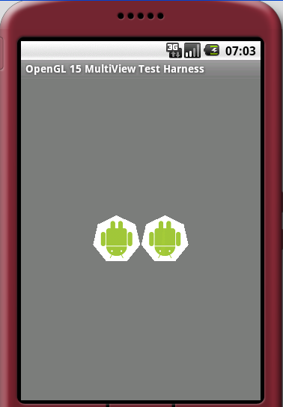
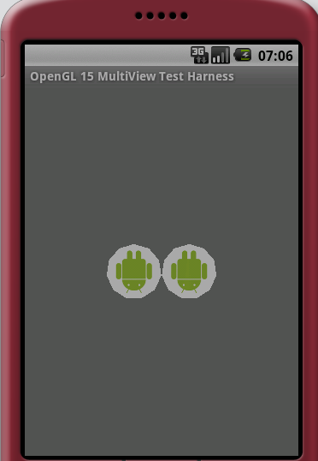
Drawing Two Textured Polygons

Slide 57
Resources 1/2
My Home Page where I am documenting Android as I explore it
http://www.satyakomatineni.com
This following book Pro Android talks about Android and also some of the content covered here.
http://www.satyakomatineni.com/akc/display?url=DisplayNoteIMPURL&reportId=3186&ownerUserId=satya
Khrons OpenGL ES api (very handy)
http://www.khronos.org/opengles/documentation/opengles1_0/html/index.html
OpenGL Red Book
http://www.glprogramming.com/red/
OpenGL Course Material from Wayne Cochran, WSU, Vancouver
http://ezekiel.vancouver.wsu.edu/~cs442/

Slide 58
Resources 2/2
My Notes on OpenGL
http://www.knowledgefolders.com/akc/display?url=NotesIMPTitlesURL&ownerUserId=satya&folderName=OpenGL&order_by_format=news
My Notes on Android 1.5
http://www.knowledgefolders.com/akc/servlet/DisplayServlet?url=NotesIMPTitlesURL&ownerUserId=satya&folderName=android+1.5&order_by_format=news
Mobile Sessions from Google I/O Conference
http://code.google.com/events/io/sessions.html#mobile
Writing Real Time Games for Android – Chris Pruett
http://code.google.com/events/io/sessions/WritingRealTimeGamesAndroid.html

Slide 59
Thank You

